Slide 1
Good Morning

Slide 2
Human Data Entry Devices

Slide 3
PRESENTED BY…
ANUSHA GYAWALI
Niraj Baniya
REETIKA PAUDEL
^{1st} SEMESTER
BACHELOR OF COMPUTER
APPLICATION

Slide 4
Introduction of Human Data Entry Device
Hardware tools designed to input information.
Input information into digital system.
Devices that require data to be entered manually.
Can be entered by typing or by pointing a device.
Types of human data entry devices, each catering to specific needs.
Examples: Keyboard, Mouse, Trackball, Joystick, Digitizing tablet, Lightpen, Touchscreen

Slide 5
Contents
INTRODUCTION
HISTORY
TRADITION WAYS AND ITS CHALLENGS
WORKING PRINCIPLE
ADVANTAGE
APPLICATIONS

Slide 6
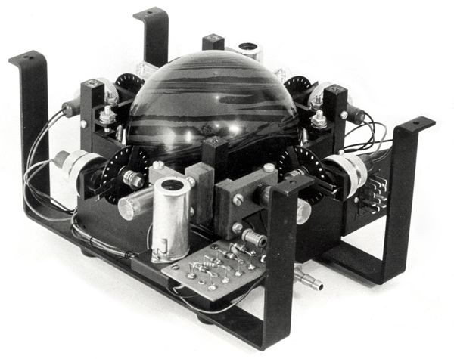
Trackball
Pointing device consisting of a ball.
Held by a socket containing sensors.
Detect a rotation of the ball about two axes.
Upside-down ball mouse with an exposed protruding ball.
User rolls the ball with fingers or the palm to move a cursor.

Slide 7
History Of Trackball
Invented by Tom Cranston and Fred Longstaff 1952.
Before the advent of the touchpad, small trackballs were common on portable computers.
Were mechanically complex and large.
Replaced by optical chopper wheel with LED.
Traditional Data Entry Challenges
Limited precision.
Cumbersome (large) interfaces.
Lack of versatility.
Ergonomic concerns.

Slide 8
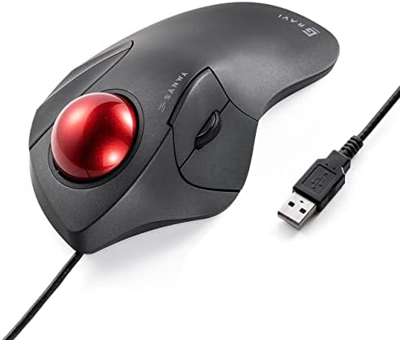
Key features
360-degree navigation for precise control.
Design for comfortable use.
Suitable for various applications.
Ideal for user with arms discomfort.
Have durable construction.
Customizable buttons.
Fig:2 Modern Trackballs

Slide 9
Advantages of Track Ball Devices
Increased precision: Fine control for data input.
Ergonomic design: Comfortable and efficient usage.
Versatility: Applicable in diverse industries.
APPLICATION OF TRACKBALL
Visual representation of the device in action.
Used in adaptive technology devices.
General computing.
Examples of use in:
Gaming
Industrial control systems
CAD (Computer-Aided Design

Slide 10
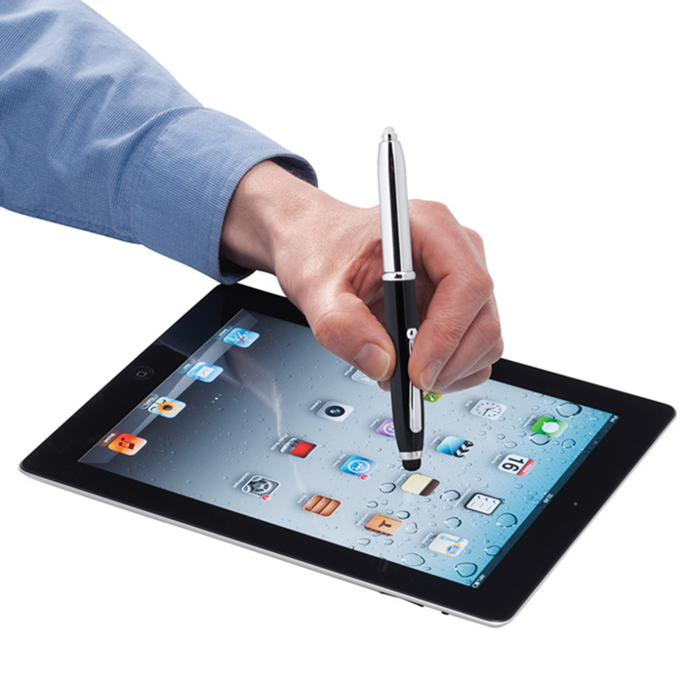
Light pen Technology
Introduction:
Pointing device which contains light sensors.
Connected to a VDU (Visual Display Unit).
Tip contains a light-sensitive element.
Enables the computer to identify the location of the pen on the screen.
Fairly simple to implement.
Works by sensing the sudden small change in brightness of a point.

Slide 11
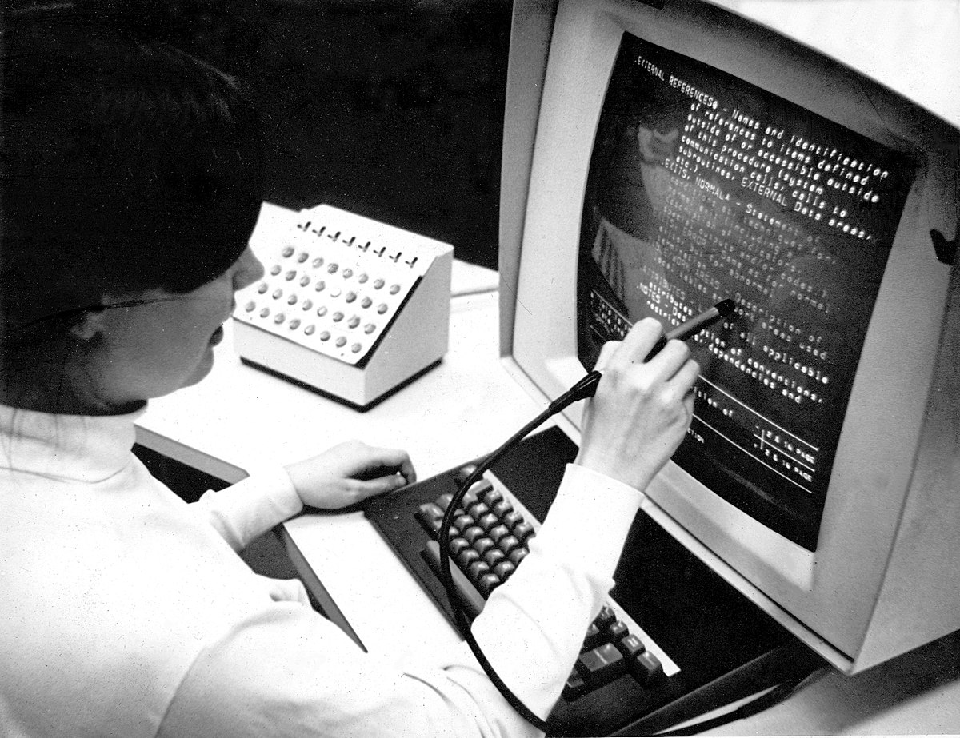
Key features:
Optical sensor for accurate pointing.
Wireless technology for freedom of movement.
Responsive and intuitive input.
Advantages of Light Pen Devices:
High precision: Accurate pointing and selection.
Wireless functionality: Enhanced flexibility.
Intuitive input: Natural and responsive interaction
Applications of Light Pen Devices:
Visual representation of the device in action.
Used as a standard pick device with many graphics system.
Examples of use in:
Image editing
Virtual environments
Educational settings

Slide 12
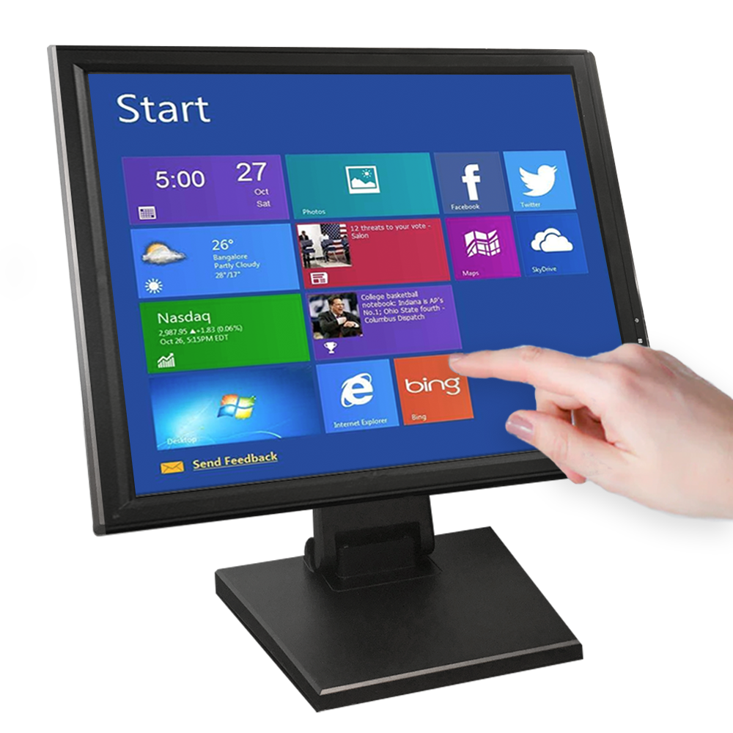
Touchscreen
Electronic display screen (input device).
A user interacts with the computer by using hand gestures.
Provide user-friendly and interactive interface.
Offers intutive navigation.
Supports multi-touch gestures.
Enhance accessibility with different abilities.

Slide 13
How does it work ?
A light pen is fairly simple to implement.
Works by sensing sudden change in brightness of a point on the screen when the election gun refreshes that spot.
Can detect the position of pen as it contact with CRT display.
Advantages
1.Saves lot of space and avoid external device.
2.Quick and efficient selection of menu options.
3.High durability and reliability.
4. User-friendly and accessible for wide range.
5. Enable user to perform multiple actions.
6. Versitle and can be used in various application.

Slide 14
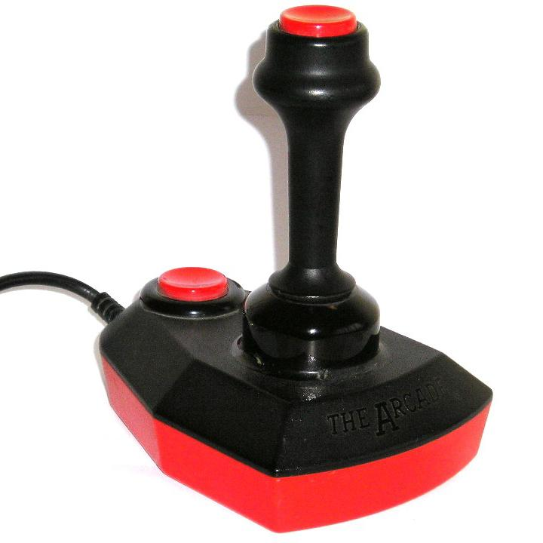
1.Input device used to control the movement. 2. Stick like handle that move in various direction. 3.Used in aviation for controlling aircraft. 4.Can be analog or digital. 5. Connect to a computer through USB, Bluetooth. 6. Compatible with variety of operating system.
Joystick

Slide 15
Key features
1. Versatile,suitable for gaming and navigation.
2. Responsible to provide quick feedback
3. Customizable with programmable buttons.
4. Compatible with various device.
Advantages
Easier to navigate around a screen.
Moves object in Easier to hold then a mouse.
Moves object in any direction.

Slide 16
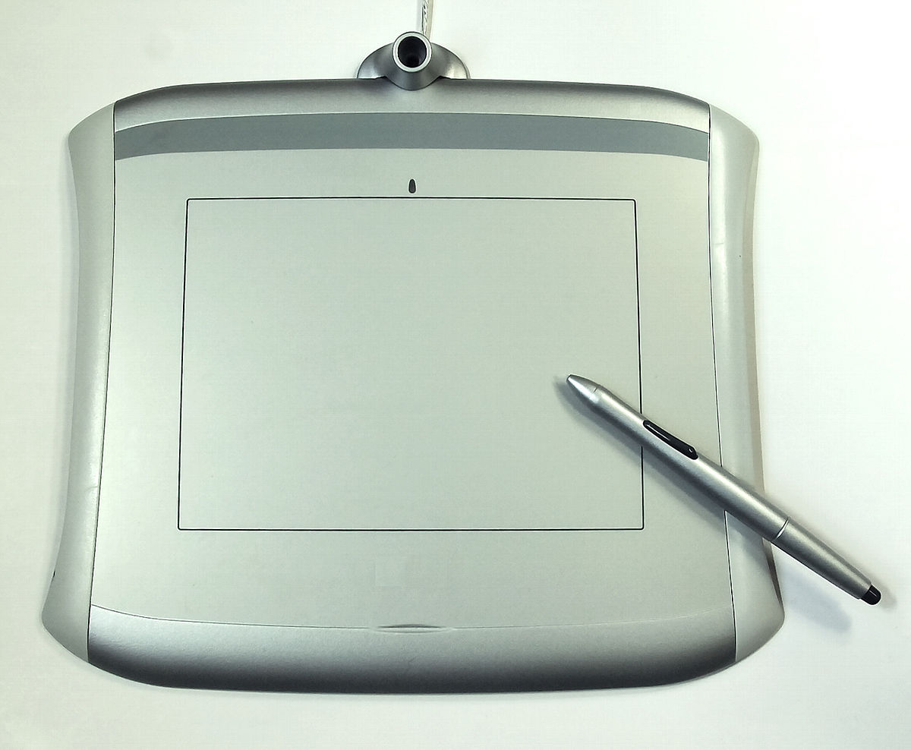
Digitizing Tablet
Allows user to create digital artwork or sketches.
Can detect varying levels of pressure by stylus.
Can be use for graphic design and animations.
Can be use for various application including:
handwriting recognization.
note-taking.
electronic document annotation.

Slide 17
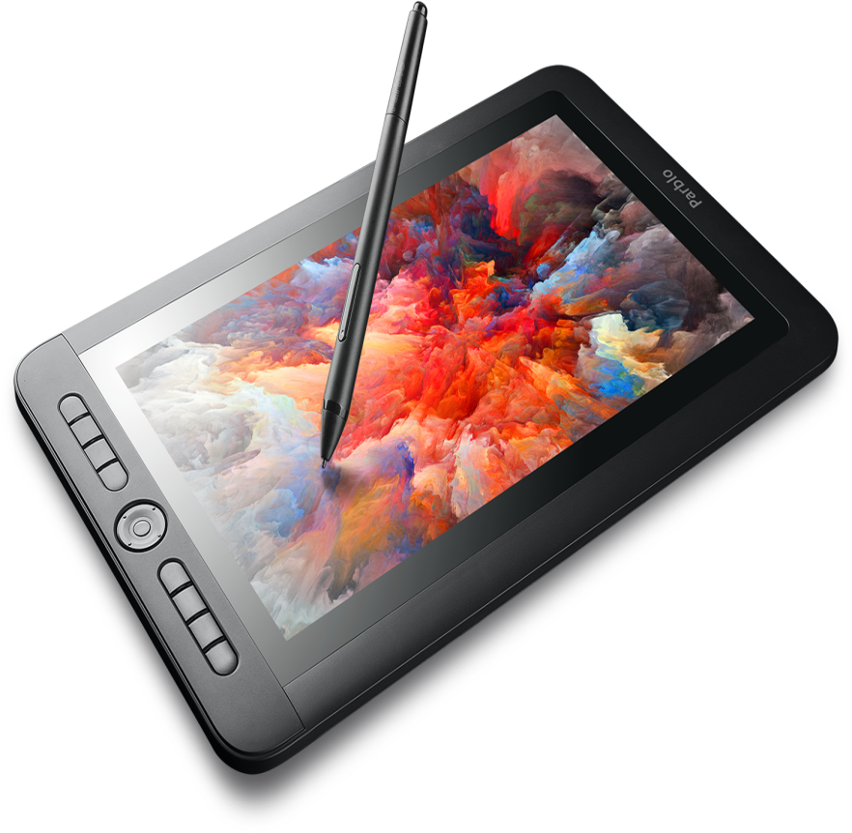
Key features
enables a user to hand-draw images, animations and graphics.
special pen-like stylus, similar to the way a person draws.
used to capture data or handwritten signatures.
enables drawings and sketches into a computer.
simple ballpoint which uses an electronic head.
detects pen movement, sends digital signals.

Slide 18
Thank You

